Slide 1
EMS/Hospital Interoperability
NEMSIS Public Training
February 6, 2024

Slide 2
Agenda
How EMS providers can participate in existing health information networks to share data
What EMS vendors need to do to implement connections with health information networks
Where to find resources for implementing interoperability in EMS
Quick wins for increasing the amount of outcome data in the national EMS database
Notes:
Poll:
What is your organizational affiliation?
EMS agency
State government
Software vendor
Researcher
Other

Slide 3




Patient
History
Hospital
Outcome
EMS
Report
Notes:
Point out problem of 1-to-1 connections: agreements, scalability, cost, effort.
For patient history, a network is essential.
Poll (multiple select):
Do you have, or offer, interoperability in these steps of the workflow?
Patient history
EMS report to hospital
Hospital outcome to EMS

Slide 4
EMS Interoperability Task Force
Monthly, 2nd Thursday, 11a–12:30p MT
Feb 8, Mar 14, Apr 11, May 9, Jun 13
Topics:
2/23: Identifying data exchange partners and establishing relationships
3/23: Governmental, regulatory, and contractual environment
4/23: Regulatory environment and national networks recap
5/23, 6/23: Sequence/workflow
7/23: Standards and profiles overview
8/23, 9/23, 10/23: Standards and profiles to use in workflow
11/23, 1/24: Patient identification and record matching
Data elements to be shared and parsed:
2/8/24: Hospital Outcomes to EMS
EMS to Hospital
Patient History to EMS
Final Report-back
Notes:
Task force purpose: to help EMS software vendors develop interoperability solutions for their customers
We’ve scheduled 2024 meetings through June, will use as needed
No call in March due to HIMSS

Slide 5
What we’ve learned…

Slide 6
Government and Regulatory Environment
EMS providers and hospitals are permitted to share protected healthcare information (PHI) with each other to carry out treatment, payment, or health care operations.
HIPAA does not require patient consent to share PHI for treatment, payment, or healthcare operations. HIPAA also permits sharing data without requiring patient consent for public health, health oversight, research, and other purposes.

Slide 7
Government and Regulatory Environment
The 21st Century Cures Act prohibits “information blocking,” practices that are “likely to interfere with, prevent, or materially discourage access, exchange, or use of electronic health information.”
If an EMS provider requests electronic health information about its patient via a health information network, and holders of the information do not provide it, the EMS provider may claim that information blocking has occurred.
Health information technology vendors cannot charge unreasonable or discriminatory fees for implementing health information exchange.

Slide 8
Data Exchange Partners
EMS vendors can connect to existing national health data exchange networks.
The networks have “common agreements”—all participants sign the same non-negotiable agreement.
Trusted Exchange Framework and Common Agreement (TEFCA) is the future of health data exchange. The predominant existing national networks are TEFCA network candidates.

Slide 9



































Notes:
Framework:
Technical Specifications
Common Agreement
Implementers & QHINs

Slide 10
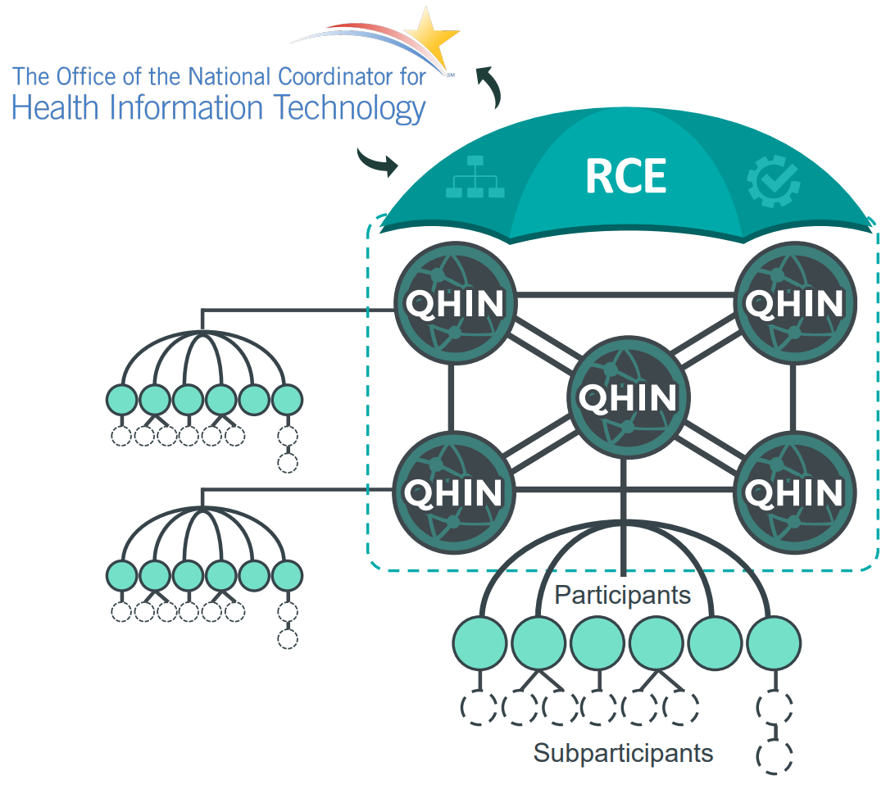
EMS Agency?
EMS Vendor?
State EMS Office?
Notes:
Poll:
Do you have interoperability? If so, what form?
No
Kind of, via web portals
Yes, via direct exchange between EMS and hospital
Yes, via a network

Slide 11
Standards Used By Networks
HL7 (Health Level 7)
IHE (Integrating the Healthcare Enterprise)
Standards for healthcare data
V2 (delimited text)
V3 (XML, SOAP)
FHIR (JSON, REST)
Profiles: collections of HL7 and other standards to solve specific interoperability problems

Slide 12
IHE Cross-Community Patient Discovery (XCPD)
IHE Cross-Enterprise Document Sharing (XDS)
IHE Cross-Enterprise Document Sharing (XDS)
IHE Patient Demo-graphics Query (PDQ)
HL7 Consolidated Clinical Document Architecture (C-CDA)?
Continuity of Care Doc.
Unstructured Doc.
HL7 C-CDA:
Continuity of Care Doc.
Discharge Summary
Referral Note
Progress Note
IHE Cross-Enterprise Document Sharing (XDS)
Patient
History
Hospital
Outcome
HL7 Consolidated Clinical Document Architecture (C-CDA)
EMS
Report

Slide 13
Task Force Next Steps
Identify the operational and clinical information that needs to be shared in each step.
Identify where that information exists within the standards used.
Create resources for transforming data between C-CDA and NEMSIS XML.

Slide 14
National Database Outcomes Challenge

Slide 15
In 2022,
hospital outcomes
were recorded on
1.4%
of PCRs
in the national EMS database
where a patient was treated and transported by EMS
Notes:
Are you getting hospital outcome data?
No
Yes, but not in our ePCR system
Yes, in our ePCR system

Slide 16
If you’re getting hospital outcome data:
Contact me.
I’ll check for outcome data from your agency/software in the national database.
If your outcome data isn’t making it to the national database, we’ll work to fix the gap.
Celebrate!

Slide 17

Joshua Legler
josh@joshualegler.com
971-264-4702
nemsis.org /using-ems-data /interoperability

